Slide 1
Proper Procedure: Fusion Joint Guided Side-Bend Test
Conforming to ASTM F3183 Procedures to Avoid False Negative Result

Slide 2
ASTM F3183 - 16

Slide 3
ASTM F3183
1. Scope
This practice provides information on apparatus, specimen preparation and procedure for conducting a guided three point side bend evaluation of a transverse specimen cut from a coupon removed from a butt fusion joint in polyethylene pipe having a wall thickness 1.00 in. (25.4 mm) and thicker. See Fig. 1.
This practice provides a means to assess ductility of a butt fusion joint by applying a lateral (side) bending strain across a specimen taken from the full butt fusion cross-section, from outside diameter to inside diameter. Yield-strain of HDPE is in the range of 9% to 12% elongation. When the R/T ratio is 2:1 , the bent strap is strained to 22% on its outside surface, and remains bent ( yielded) after testing. Use of specimens thicker than ¼” ( 0.25” ) will just over-strain “torture” the polyethylene specimen, potentially resulting in false negatives
No test values are provided by this practice. The result is a non-numerical report. Criteria for test result evaluation are provided in standards or codes that specify the use of this practice by comparison to benchmark laboratory results.

Slide 4
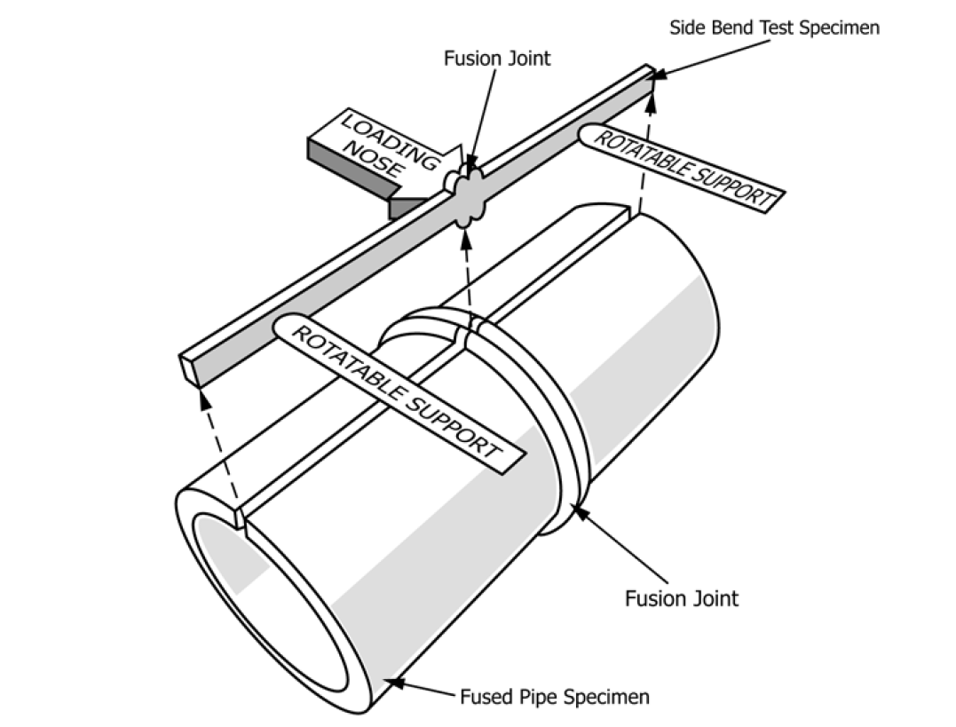
Proper Coupon Extraction – Cut and Plane 2 Sides Smooth
The coupon for testing must be removed along the axis of the pipe, as follows. Other cross-sectional specimen extraction locations may/will lead to a false negative (potential cracking).

Slide 5
Test Specimen: Planed Flat – Nominal ¼” thick Leave Fusion Beads Intact

Slide 6
Test More Than One Specimen -- Length
Cut the fusion-joint specimen from the fused pipe-ring, about 12” to 18 inches long, sufficient to feed through the planner to smooth the two sides and reach the ¼” nominal thickness. The fusion joint should be centered with approximately equal lengths to each side of the butt-fusion joint.
Typically, bend test coupon “pairs” are cut from a position around the fused pipe-ring circumference, and the position directly opposite on the other half of the butt fusion joined pipe sample.
Optionally, segmenting larger diameter butt-fusion joined pipe rings into four or more equal sections (quadrants, sixths, eighths, etc.) provides additional bend test coupon pairs.
Side bend test specimens are prepared from bend test coupon pairs that are cut from a sample butt fusion. The sample butt fusion is two approximately equal lengths of polyethylene pipe that are joined in the middle by a butt fusion. The two pipe lengths to each side of the fusion joint shall be at least 6.0 in long so that the overall length of the sample butt fusion equals or exceeds the 12.0 in minimum overall length of the bend test coupon.

Slide 7
Test Apparatus : ¼ “ specimen – ½ “ Radius Nose

Slide 8
Acceptance Criteria
Benchmark criteria for evaluating field testing results
are developed by testing a statistically valid number of sample
butt fusions in a controlled environment, preferably using
equipment for field use.
Guided side bend test results from field
tests are then evaluated by comparison to benchmark test
results from the controlled environment.

Slide 9
Speed of Travel --
The slow rate of vertical downward travel in extension of the mandrel nose bar, shall be 2-inches per minute to 3 inches per minute vertical 3.0 6 1.0 in./min.
The loading nose applies force across the full width of the side bend test specimen (plus the fusion beads) and bends the specimen between the two rotatable supports. The loading nose is a cylindrical bar having a radius of ½ “ (0.50 in.) for its full length where it contacts the test specimen.
The “nose” of the bending mandrel should be centered over the middle of the pipe-wall fusion joint, contacting the fusion centerline across the test specimen width.

Slide 10
Bent Test Specimen –Centered on Fusion Joint

Slide 11
Location of Test Specimen Removal

Slide 12
Specimen Preparation -- Cut & Plane

Slide 13
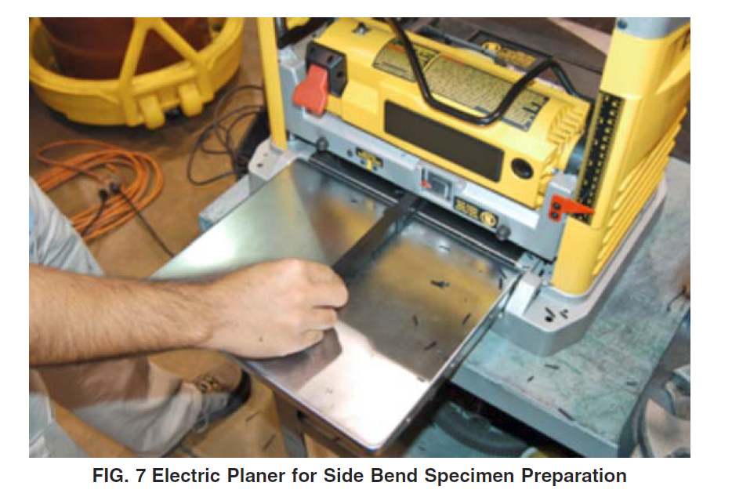
Plane 2 sides Smooth to About ¼” Thick.

Slide 14
Test at About 65F -75F Temperature-
Conduct side bend testing in air at a temperature of 65-75° F.
When conducting field tests, exposed side bend test equipment could be at a temperature well above or below 65°-75° F.
If very hot or cold, heat transfer of the metal apparatus to the specimen could affect results.
Measure the temperature of the environment, apparatus and specimen at the time of the testing using a pyrometer or other temperature measurement device.

Slide 15
Specimen Wraps Mandrel- Does Not “Hinge”
Care shall be taken to insure that the surface of the specimen remains in full and continuous contact with the outer diameter of the loading nose as it is deflected.
During the test, if a gap, visible to the naked eye, develops between the loading nose surface and the side-bend test specimen, the test procedure shall be discontinued, the side bend test specimen removed and testing of a new side bend test specimen shall be initiated.
NOTE:—The appearance of a gap between the side bend test specimen and the outer diameter of the loading nose during the deflection process can result in “hinging” of the side bend test specimen.
This could result in a highly intensified bend strain across the fusion joint, due to extremely smaller bending curvature, giving an improper or inaccurate result.
The side bend test practice assumes that the test specimen is wrapped in a full and continuous fashion around the surface of the loading nose upon deflection during the test procedure.

Slide 16
Interpretation of Results
Test results obtained are non-numerical and are comparisons.
Interpretation of test results as it may pertain to acceptability or qualification of the fusion procedure used to produce the butt fusion joint or the qualification of the fusion operator performing the fusion procedure is outside the scope of this ASTM F3183 practice.
When side bend test results do not meet expectations, the user should investigate to determine the cause by evaluating the side bend test procedure utilized, the butt fusion procedure, adherence to the butt fusion procedure, the capability of the fusion equipment, or the pipe material characteristics to determine the root cause of the result.
Testing of pipe test specimens made in orientations other than that shown in the standard may / will result in false negatives.

Slide 17
Invalid, Improper Test Specimen

Slide 18
Invalid, Improper Test Specimen

Slide 19
Thank You!
Presentation by Harvey Svetlik
For Further HDPE Pipe Information, Please Contact:
Gajeske, Inc.
6200 N. Houston Rosslyn Road
Houston, Texas 77091
www.gajeske.com
713-688-2728
© MMXX Gajeske, Inc.

